Slide 1
CS6650 Lab 6
Francisco Proboste
Spring 2022 – NEU Vancouver

Slide 2
Client
API Server
Post
General Threads
Runable Class
HttpServlet Framework
Time
Main Thread
Ph 1
Ph 2
Ph 3
SkierServlet
ResortServlet
StatisticsServlet

Slide 3
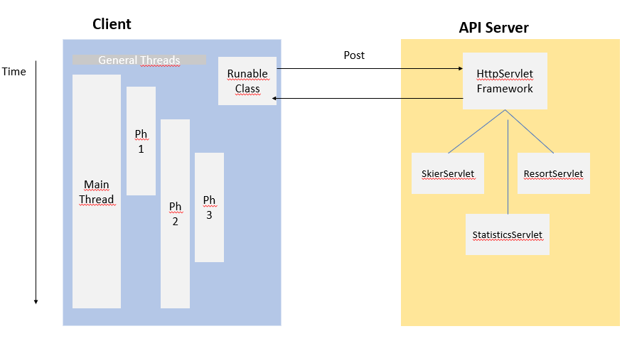

(local)
(local)
Consumer (local)
Threaded Basic Consume
EC2

Slide 4
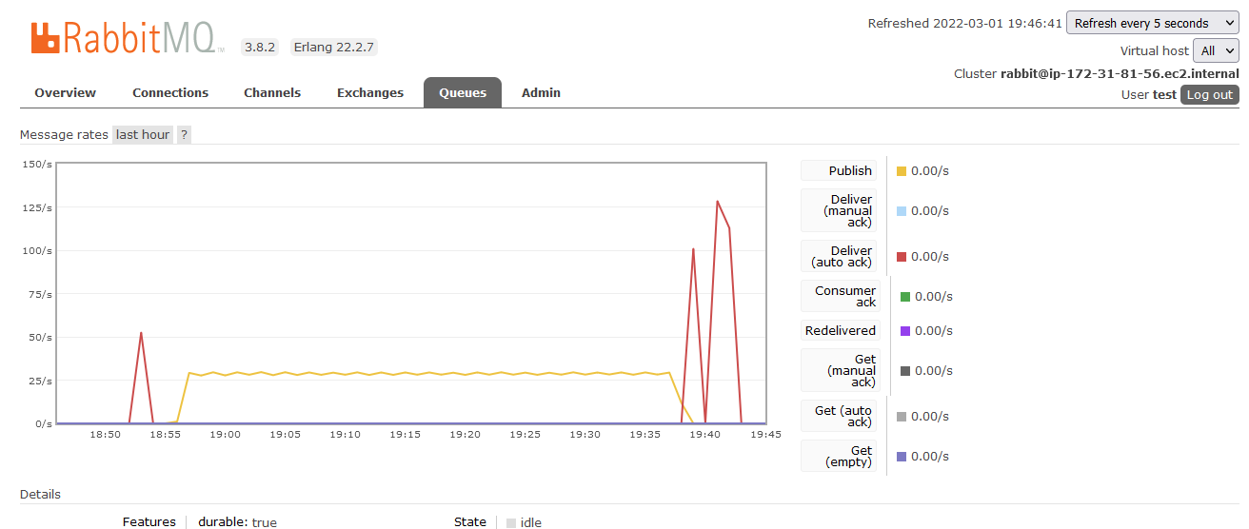
Case 64 threads -> 30 publishes/second

Slide 5
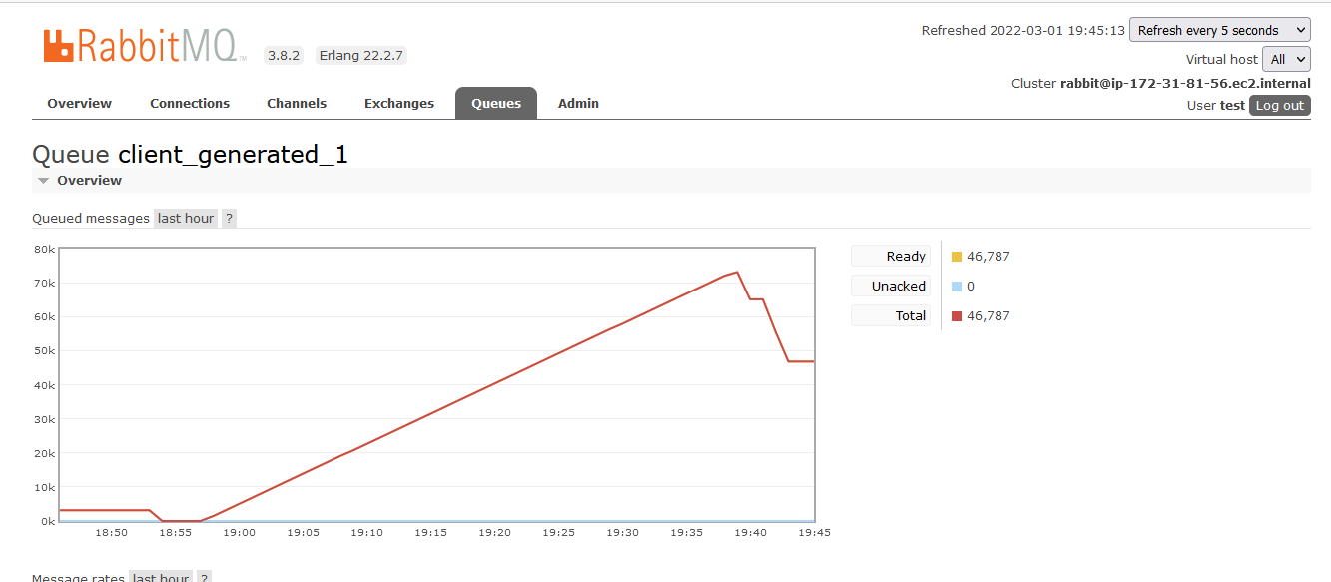
Case 64 threads -> 40 mins to reach 70 k.

Slide 6
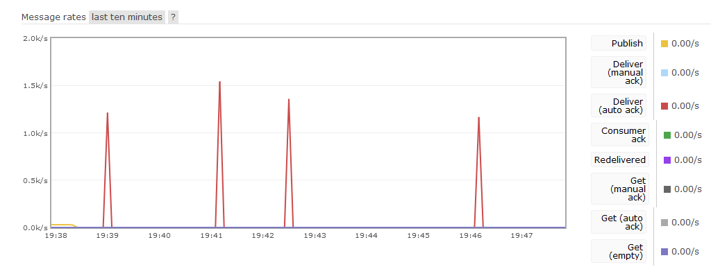
Basic Consume implementation working erratically

Slide 7
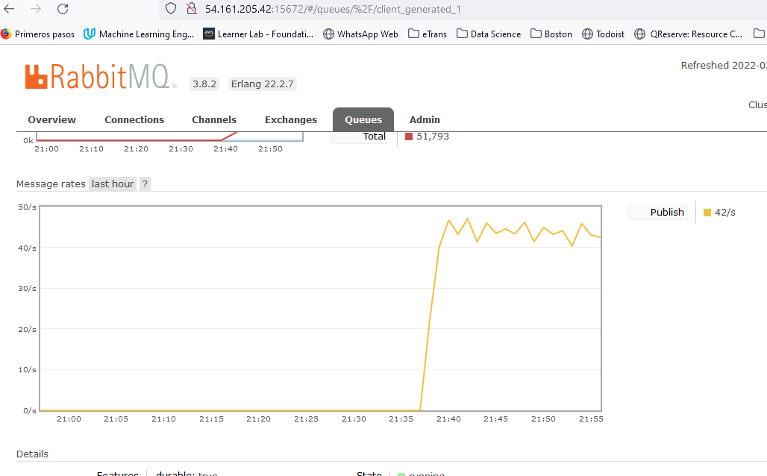
Case 128 threads -> 47 publishes/second

Slide 8
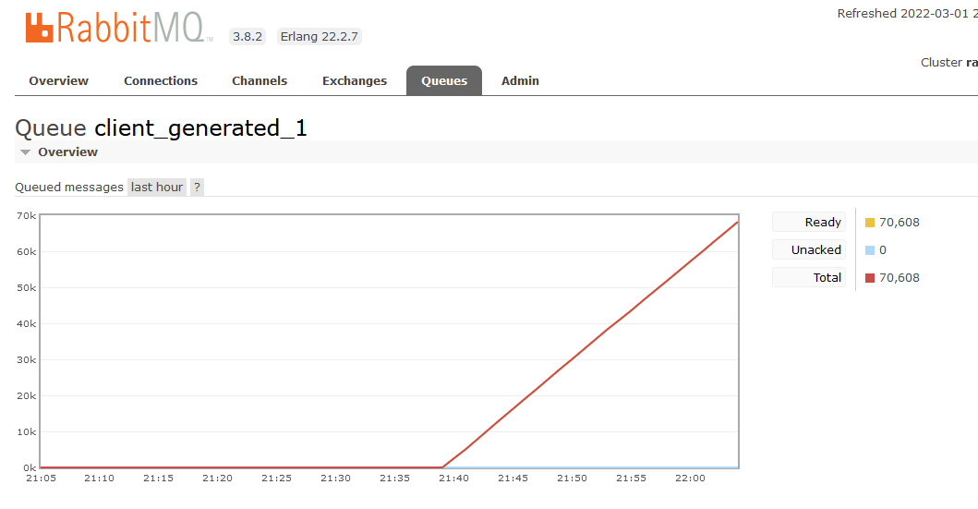
Case 128 threads -> 25 mins to reach 70 k.

Slide 9
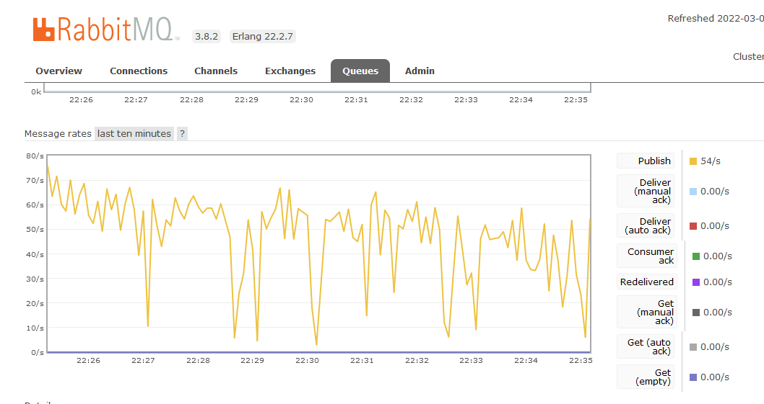
Case 256 threads -> 58 publishes/second

Slide 10
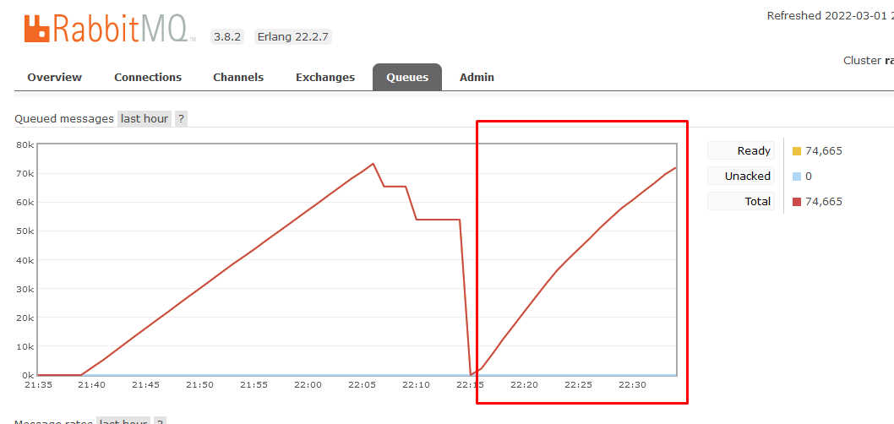
Case 256 threads -> 20 mins to reach 70 k.

Slide 11
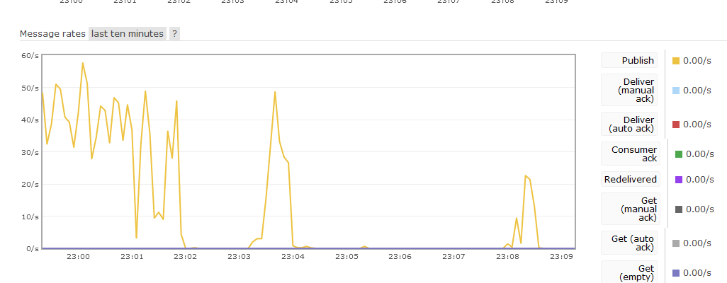
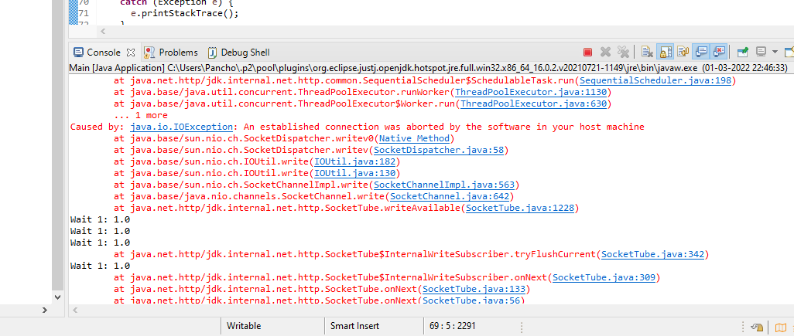
Case 512 threads -> collapse

Slide 12
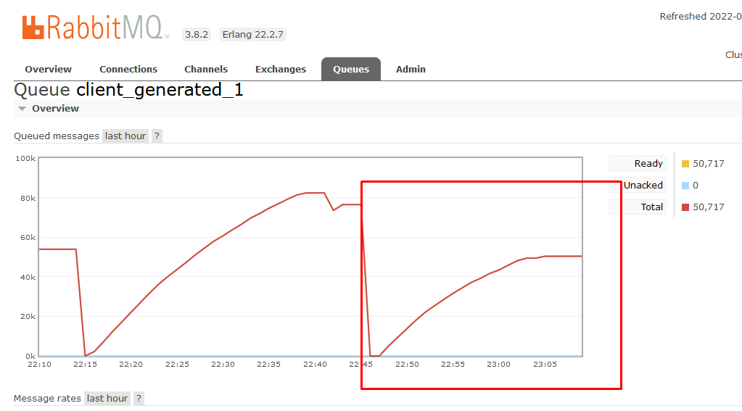
Case 512 threads -> collapsed after 40K

